Slide 1


UW Data Challenge

Slide 2
Overview
Three parts of the challenge:
Oral Presentation
Model
Written Presentation
Instructions here
All Due October 13th at 5:00 PM → Presentation Date!
The project is able to be done individually, but you may also work in groups of up to three people

Slide 3
Dataset
Goal: predict the rate of death in patients who’ve had heart failure
Almost 300 patients with 12 different health measurements for each patient
Have to clean and prepare the dataset for analysis
Make your own test dataset as you deem necessary

Slide 4
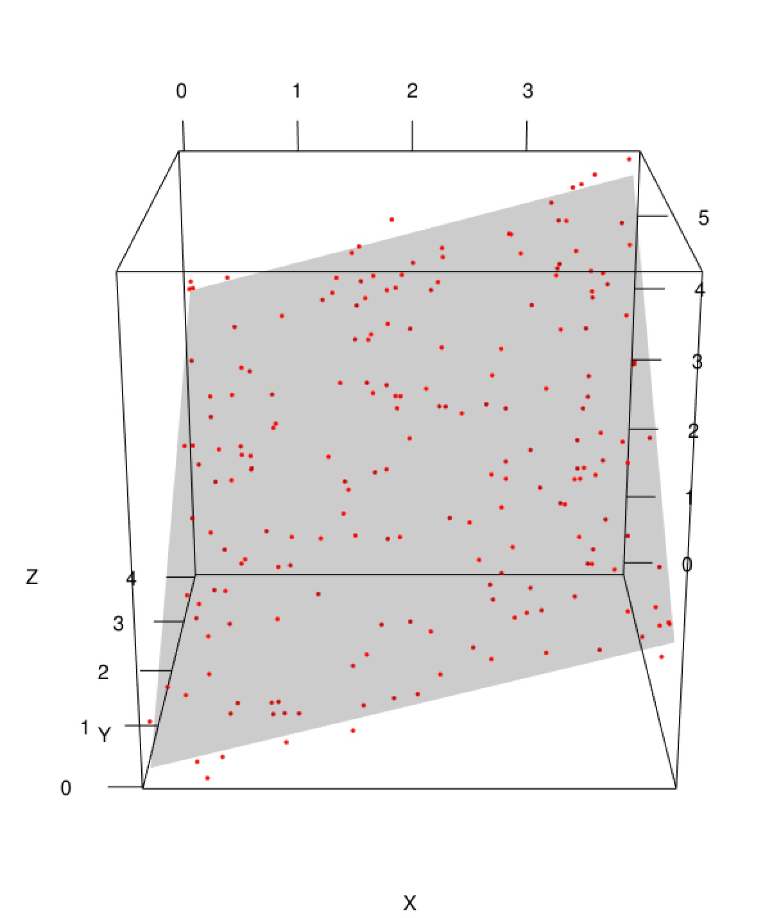
Model
All levels of models are welcome
Anything from looking at basic probabilities to machine learning
Models aim to accurately predict which patients will die of heart failure given their health information
Any code you write will have to be submitted!

Slide 5
Suggestions
Try simple models first! Linear regression is usually decent…
Check to see if all the variables have an effect on the outcome
If you want to code, R or Python are the best
Feel free to try more complex models (clustering, decision trees, neural networks, etc.)

Slide 6
Executive Report
One to Two page analysis of your model and the data given
Should answer more than just model accuracy
Full list of possible questions to answer will be on the Instruction sheet

Slide 7
Oral Report
Zoom presentation given in front of a panel of Statistics grad students and professors
3-5 Minutes long, everyone in the group should participate
Present your findings on the data and your model

Slide 8
Scoring
Judges will look at all three areas: the model, the written presentation, and the oral presentation
Four certificates given out:
Best Oral Presentation
Best Written Report
Most Accurate Model
Best Visualization
Team with highest rubric score wins $50 and a chance to go to MUDAC

Slide 9
Questions?
If you are looking for a team but do not have one, talk to one of the board members once the meeting is over.

